Slide 1
Responder pricing landscape

Slide 2
Headline

Slide 3
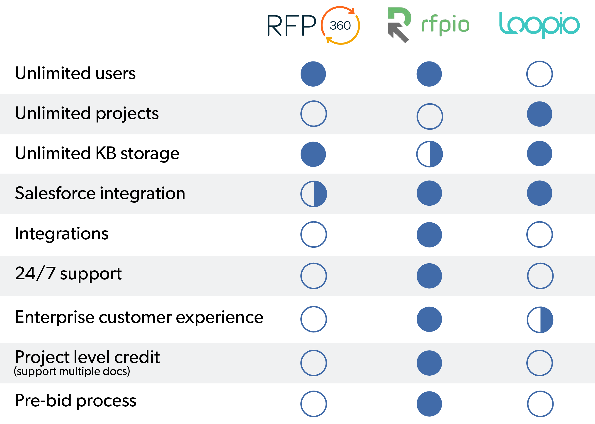
Headline

